Slide 1
Defect Management Day 5

Slide 2
What is a Defect?
A flaw in any aspect of software or requirements that may contribute to the occurrence of one or more failures
It is the manifestation of an error, which is also called as a Bug or Fault
During test execution, if the expected results does not match with the Actual result, then a defect is encountered.

Slide 3
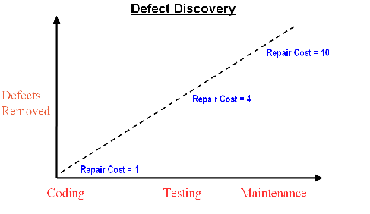

Slide 4
Cause of Defect
Defects in software are mainly due to
Software complexity
Programming errors
Changing requirements
Missing logic
Time pressures
Non-Conformance to Specifications

Slide 5
Types of Defects
Defects are classified into categories by the nature of the defect. The following are the classification
Showstopper
Critical
Non critical

Slide 6
Types of Defects:
Showstopper (X):
The impact of the defect is severe.
The system cannot go into the production environment without resolving & an interim solution may not be available.
Critical (C):
The impact of the defect is severe, however an interim solution is available.
The defect should not hinder the test process in any way.

Slide 7
Types of Defects
Non critical (N):
These are the defects that could potentially be resolved via documentation and user training.
These can be Graphic User Interface (GUI) defects are some minor field level observations.

Slide 8
Defect Logging & Reporting
Defects will be logged & reported by the Test Team in a Defect tracking Tool
Defect Logs such as screen shots should be maintained for each defect and reported to the development team.
Detailed information (description with data used) to reproduce and fix

Slide 9
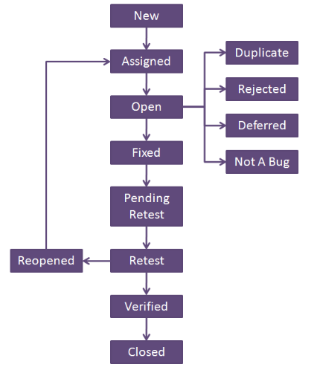
Defect Life Cycle

Slide 10
Defect Status Defect status indicates the state of a defect record at the time it was stored in the data repository.
New: When a defect is logged and posted for the first time. It’s state is given as new.
Open: At this state the developer has started analyzing and working on the defect fix.
Fixed: When developer makes necessary code changes and verifies the changes then he/she can make bug status as ‘Fixed’ and the bug is passed to testing team
Pending retest or Ready to Test: After fixing the defect the developer has given that particular code for retesting to the tester. Here the testing is pending on the testers end. Hence its status is pending retest
Retest: At this stage the tester do the retesting of the changed code which developer has given to him to check whether the defect got fixed or not
Verified: The tester tests the bug again after it got fixed by the developer. If the bug is not present in the software, he approves that the bug is fixed and changes the status to “verified”
Reopen: If the bug still exists even after the bug is fixed by the developer, the tester changes the status to “reopened”. The bug goes through the life cycle once again.
Assigned: After the tester has posted the bug, the lead of the tester approves that the bug is genuine and he assigns the bug to corresponding developer and the developer team. It’s state given as assigned

Slide 11
Defect Status
Closed: Once the bug is fixed, it is tested by the tester. If the tester feels that the bug no longer exists in the software, he changes the status of the bug to “closed”. This state means that the bug is fixed, tested and approved
Rejected: If the developer feels that the bug is not genuine, he rejects the bug. Then the state of the bug is changed to “rejected”.
Deferred: The bug, changed to deferred state means the bug is expected to be fixed in next releases. The reasons for changing the bug to this state have many factors. Some of them are priority of the bug may be low, lack of time for the release or the bug may not have major effect on the software.
Not a bug/By Design: The state given as “Not a bug” if there is no change in the functionality of the application. For an example: If customer asks for some change in the look and feel of the application like change of colour of some text then it is not a bug but just some change in the look of the application.
Duplicate: If the bug is repeated twice or the two bugs mention the same concept of the bug, then one bug status is changed to “duplicate“.

Slide 12
Retesting Vs Regression Testing
Regression testing
WHAT: Regression testing –Testing the application as a whole for the modification in any module or functionality to ensure that modification doesn't impact the existing functionality
How : Difficult to cover all the system in regression testing so typically automation tools are used
• WHY: To ensure whether the new introduced feature doesn’t affect the existing functionality.
• WHEN: Before the application “Go live”.

Slide 13
Regression Testing Vs Retesting
Regression testing
WHAT: Regression testing –Testing the application as a whole for the modification in any module or functionality to ensure that modification doesn't impact the existing functionality
How : Difficult to cover all the system in regression testing so typically automation tools are used
• WHY: To ensure whether the new introduced feature doesn’t affect the existing functionality.
• WHEN: Before the application “Go live”.

Slide 14
Retesting
What: After a defect is detected and fixed, the software should be retested to confirm that the original defect has been successfully removed
How : You cannot automate the test cases for Retesting. So it will be done manually
•WHY: To make sure that the tests cases which failed in last execution are passing after the defects against those failures are fixed.
•WHEN: Every time after the defect is fixed

Slide 15
Time for Clarifications !!

